Slide 1


Methodologies for Implementation of Standard-Cell Libraries for Radiation Hardened Environments
Ryan Ridley and James E. Stine, Jr.
VLSI Computer Architecture Research Laboratory
School of Electrical and Computer Engineering
Oklahoma State University
Stillwater, OK 74078 USA
George Suárez NASA Goddard Space Flight Center Instrument Electronics Development Branch, Code 564 Greenbelt, MD 20771
IEEE Latin American Symposium on Circuits and Systems (LASCAS), February 27, 2024 – March 01, 2024

Slide 2
Outline
Introduction
Radiation Effects
Radiation Hardened by Design (RHBD)
Implementation and Comparison
Conclusion

Slide 3
Trouble with Rad-Hard ASICs
Very low demand for rad-hard ASICs
Aerospace companies like NASA, SpaceX, Blue Origin, etc
Nuclear plants
Military applications
Limited commercial availability for rad-hard libraries
TI has a space products line
Increased complexity of design
N-Modular redundancy requiring the addition of some form of voter logic
More expensive
RH layout techniques increase power and area
Man hours devoted to converting standard library to RHBD

Slide 4
Radiation Effects
Single Event Effect (SEE)
Caused by a single high energy particle. SEEs come in three forms:
Single Event Transient (SET)
Rapid change in charge that causes temporary voltage flucuations on signal lines. Non-destructive.
Single Event Upset (SEU)
Like SETs but cause bit-flips in memory cells/registers which can propagate errors. Non-destructive.
Single Event Latchup (SEL)
Causes high operating current above device specifications that can only be cleared by a power reset. Possibly destruction.
Total Ionizing Dose (TID)
Long term effects from radiation exposure.
Main focus for this library.

Slide 5
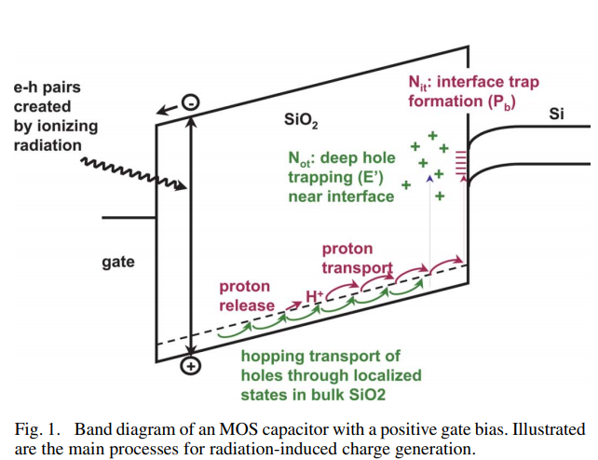
Total Ionizing Dose (TID)
Chronic exposure to radiation over time.
Creates trapped charges in the oxide due to the electrical properties of insulators.
This causes shifts in device parameters leading to complete failure.
Overall, this is going to decrease the threshold voltage of NMOS making them leaky and PMOS will become harder to turn on
J. R. Schwank et al., "Radiation Effects in MOS Oxides," in IEEE Transactions on Nuclear Science, vol. 55, no. 4, pp. 1833-1853, Aug. 2008, doi: 10.1109/TNS.2008.2001040.

Slide 6
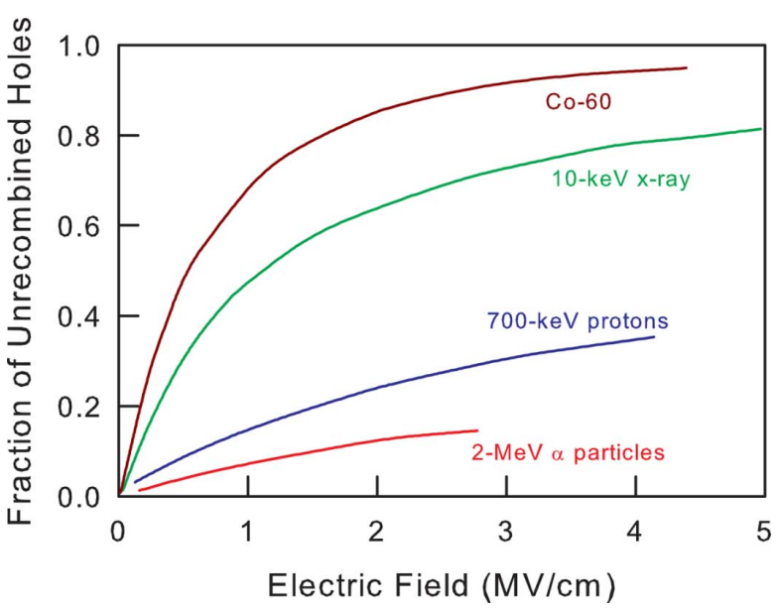
Total Ionizing Dose (TID)
For higher radiation like Co-60 (12-MeV) which are gamma rays, close to 95% of the charge. generated is trapped in the oxide.
Different types of radiation will vary what type of SEEs are common and amount of TID.
As the electric field is increased, there is less of chance of recombination of the e-h pair, further increasing TID.
J. R. Schwank et al., "Radiation Effects in MOS Oxides," in IEEE Transactions on Nuclear Science, vol. 55, no. 4, pp. 1833-1853, Aug. 2008, doi: 10.1109/TNS.2008.2001040.

Slide 7
Radiation Hardened by Design (RHBD)
RHBD is an effective way to mitigate radiation effects through design choices made on the device, layout, or architectural level.
Device
Silicon-on-Insulator (SOI)
Silicon-on-Sapphire (SOS)
Trench Isolation
Thinner Oxide Layer
Layout
Annular Gates
Diffusion Rings
Architectural
Triple Modular Redundancy (TMR)

Slide 8
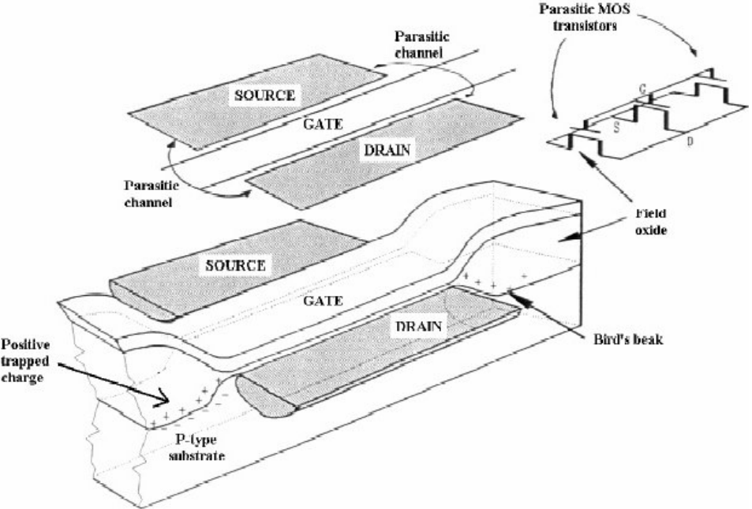
Annular Gates
In traditional rectangular gates, significant current leakage from the oxide happens at the “bird’s beak” junction.
This creates parasitic channels from the source to the drain.
Shah, S. (2003). Study of SOI Annular MOSFET (Unpublished master's thesis). Oklahoma State University.

Slide 9
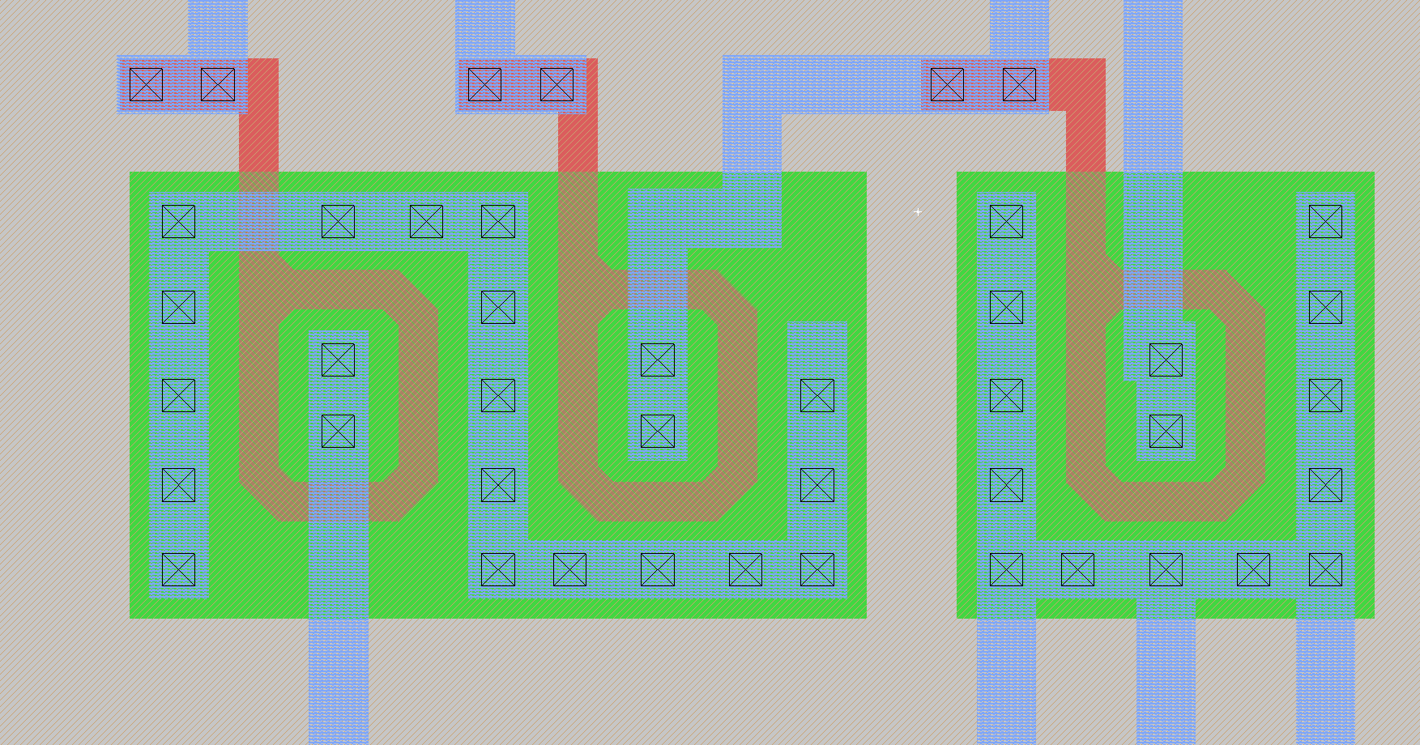
Annular Gates
Having an enclosed source/drain removes parasitic channels that develop between source and drain.
Developed through use open-source Magic + CDS Virtuoso interfaces.

Slide 10
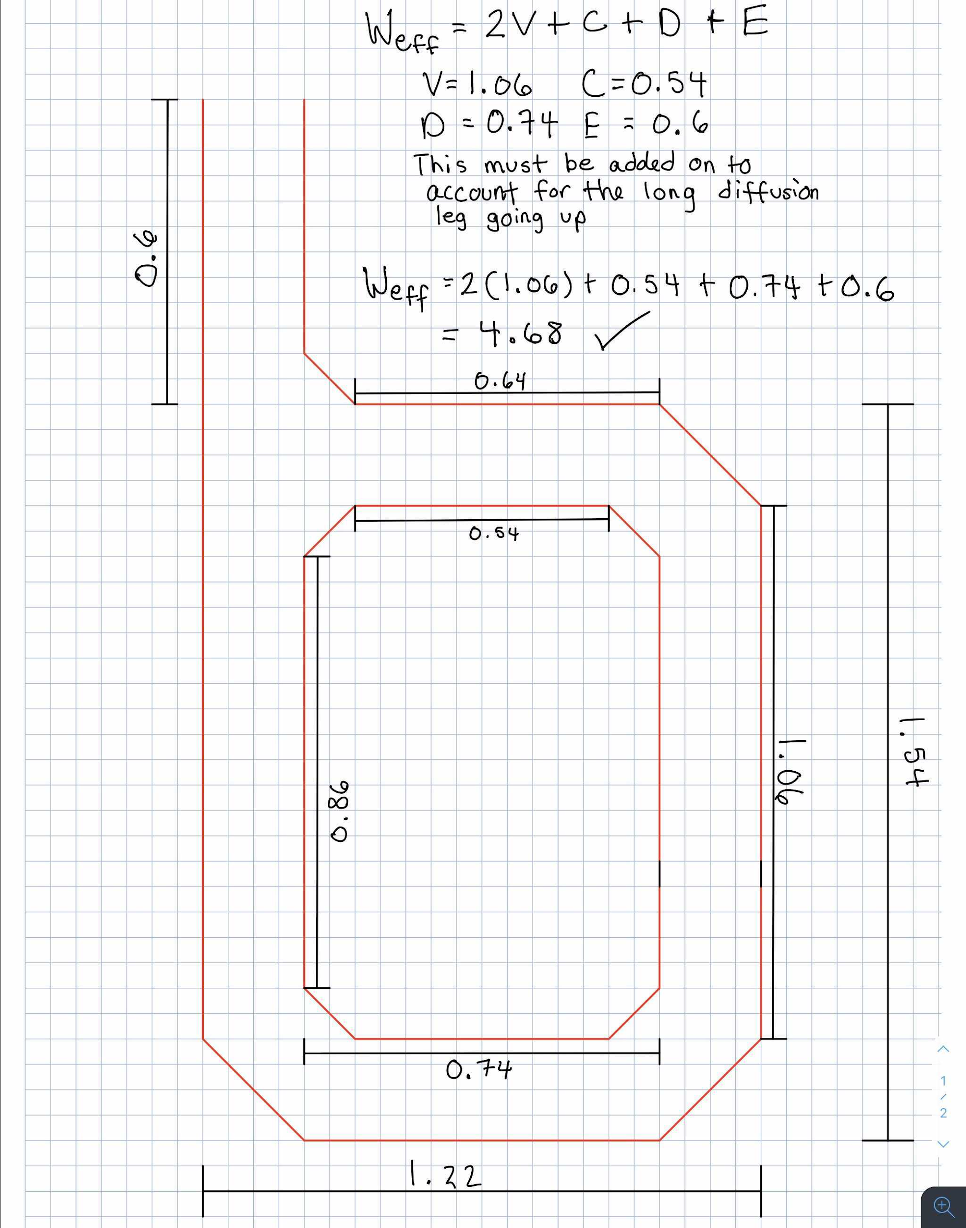
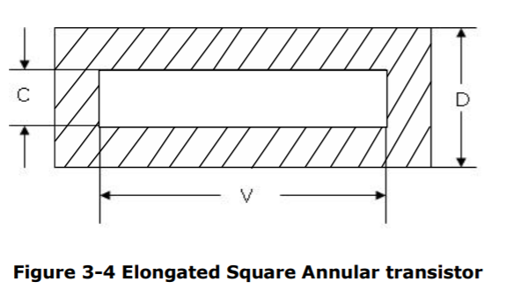
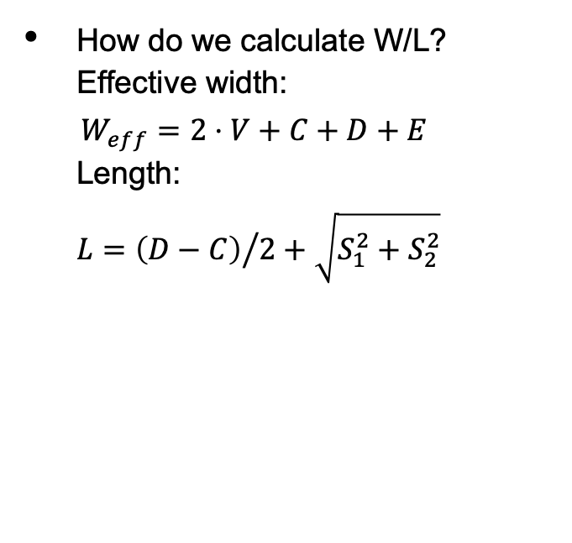
Annular Gate W/L
How do we calculate W/L?
Effective width:
$$W_{eff}=2⋅V+C+D+E$$
Length:
$$L={\left(D−C\right)}/{2+\sqrt{S_{1}^{2}+S_{2}^{2}}}$$
E is the length of the tail in the diffusion and S1/S2 is the length of the 3 outside/inside corner diagonals (bottom left, bottom right, top right).
Shah, S. (2003). Study of SOI Annular MOSFET (Unpublished master's thesis). Oklahoma State University.

Slide 11
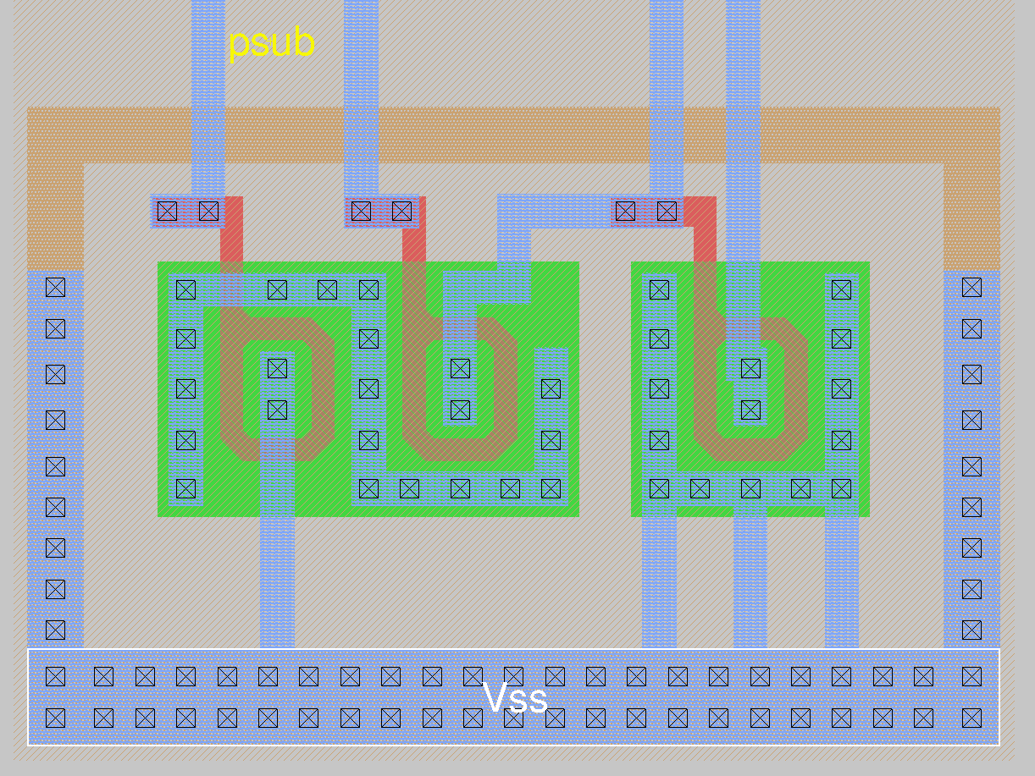
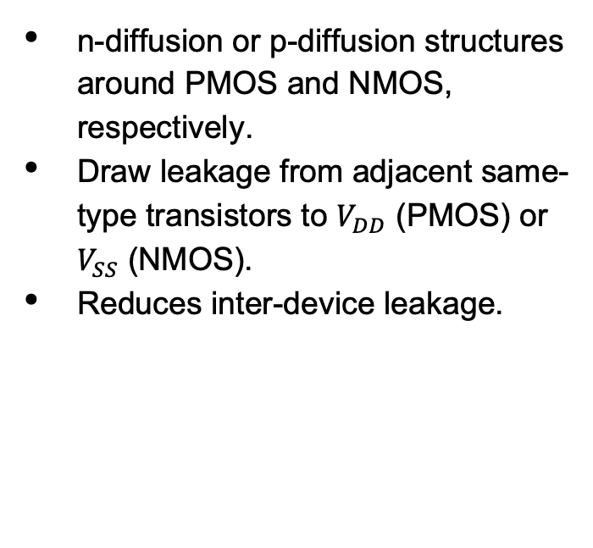
Diffusion Rings
n-diffusion or p-diffusion structures around PMOS and NMOS, respectively.
Draw leakage from adjacent same-type transistors to $V_{DD}$ (PMOS) or $V_{SS}$ (NMOS).
Reduces inter-device leakage.

Slide 12
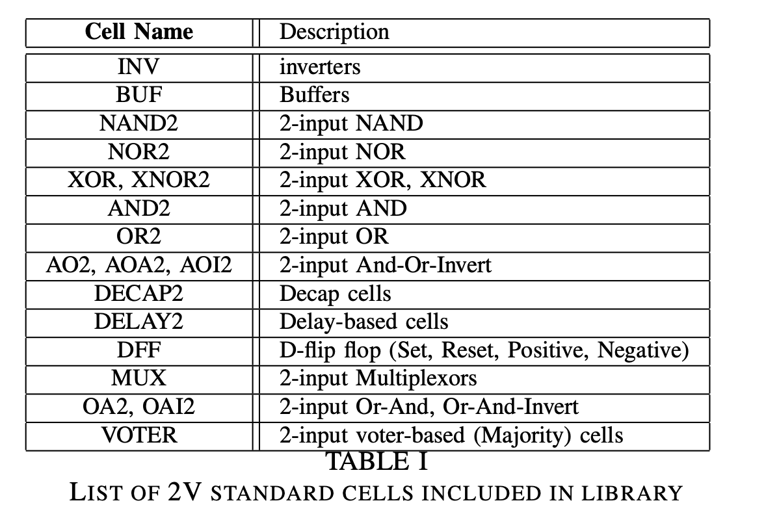
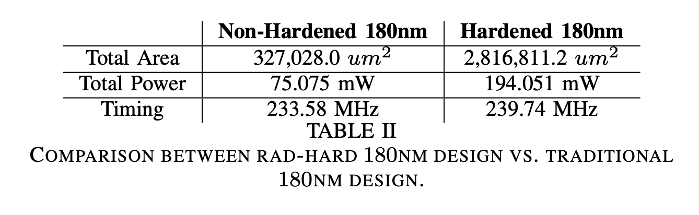
1.8V Standard-Cell LIbrary
Library created in Magic layout tool using a 180nm technology.
Implements annular gate and diffusion ring RHBD techniques.
92 standard-cells including TMR D Flip-Flop cells.
The library was characterized using Cadence Design System’s Liberate tool.
Comparisons done versus a non-hardened library.

Slide 13
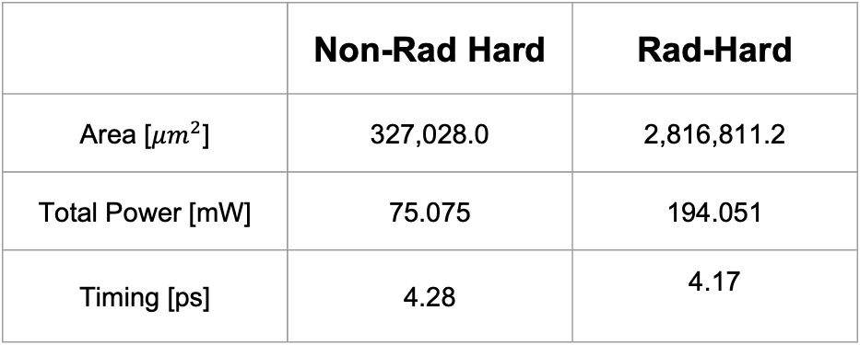
Comparison - Synthesis
Design: Gatekeeper RISC-V Single Cycle
Clock speed: 350 MHz
Synthesis tool: DC Shell
Operating Voltage: 1.8V
Corner: TT
Temp: 25ºC
 | Non-Rad Hard | Rad-Hard
Area [$μm^{2}$] | 327,028.0 | 2,816,811.2
Total Power [mW] | 75.075 | 194.051
Timing [ps] | 4.28 | 4.17
← 8x increase in area
← 2.5x increase in
power

Slide 14
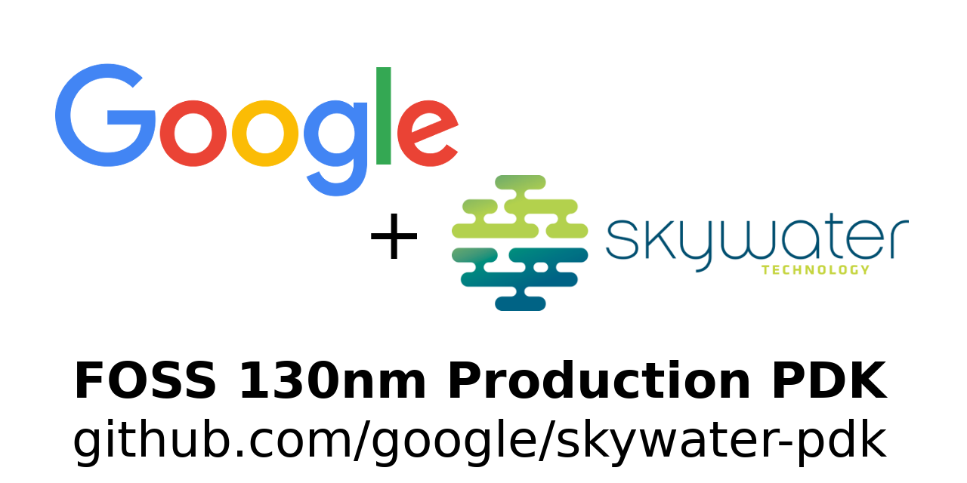


Released skywater-pdk!
FOSS 130nm manufacturable PDK
Open-Source ASIC Tooling
Notes:
Google + SkyWater launch open source PDK
https://github.com/google/skywater-pdk
https://skywater-pdk.readthedocs.io/en/latest/index.html
https://news.ycombinator.com/item?id=23524428
paulgerhardt 8 days ago [–]
This is a watershed moment.
An open PDK was the last road block for making open silicon chips.
It’s as important as say when Linus introduced an open source kernel with Linux after GNU had bumbling around getting nowhere for years.
A PDK is roughly analogous to what an assembler does for code in the code => compiler => assembler => machine code tool chain. Previously there were open silicon compilers but not open silicon assemblers.
A malicious party could inject all sorts of nastiness into your code if they control the assembler. The same is true for PDK’s. A malicious gate placement in just the wrong spot and your entropy source is massively compromised. Every piece of software runs on silicon - this would allow for the entire stack to be auditable for the first time. It lets you verify your open titan chip in your 2FA token is actually an open titan chip and not some made in China clone with a Bluetooth backdoor and titan badging.
I feared Sky Water gave up on releasing this PDK when an earlier initiative with another entity fell through. Glad to see Google step in and push this over the finish line.

Slide 15
Conclusion
RHBD techniques can be an effective way to combat radiation effects without having to use manufacturing techniques like Silicon-on-Insulator (SOI) or Silicon-on-Sapphire (SOS)
A significant tradeoff using RHBD techniques is an increase in power and area
Through testing with Berkeley’s 88-inch cyclotron, current design hardiness is tolerant against latchup over 75 MeV
To help showcase more RHBD designs utilized in this library, we adapted for SkyWater Technology 130nm cells and available here (all files included):
https://github.com/stineje/sky130RHBDLib

Slide 16
QUESTIONS?

